Slide 1
MADHUSUDAN LAW UNIVERSITY
USER GUIDE FOR STUDENT FORM FILL UP

Slide 2
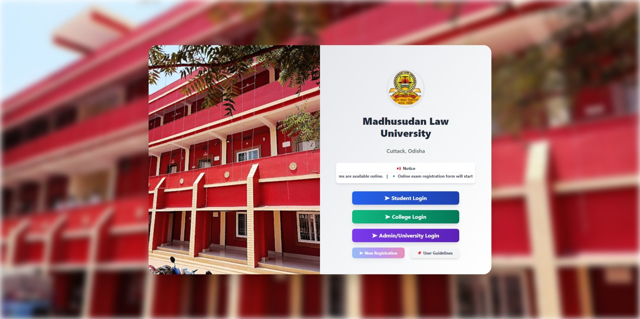
Step 1: Access the Login Page
To begin, open your web browser and go to the Madhusudan Law University student login page by clicking on the following
link: https://mlu.datatech.ind.in/LogIn.aspx and click to Student Login

Slide 3
(I) Login Page
Students can log in to access course details, exam registration, and results, while colleges manage student data, and admins oversee operations. New students must complete registration before accessing services. Check the "User Guidelines" and notifications for updates or assistance.

Slide 4
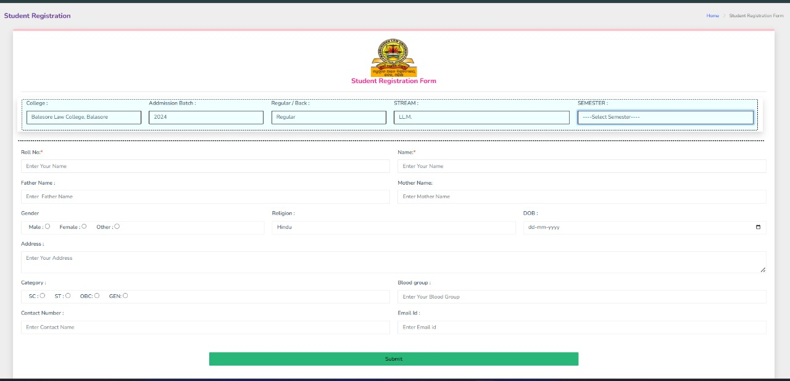
(II) Registration Page
Please fill in all the required fields accurately, including your name, roll number, and contact details. Ensure you select the appropriate category, semester, and other relevant options before clicking the "Submit" button.

Slide 5
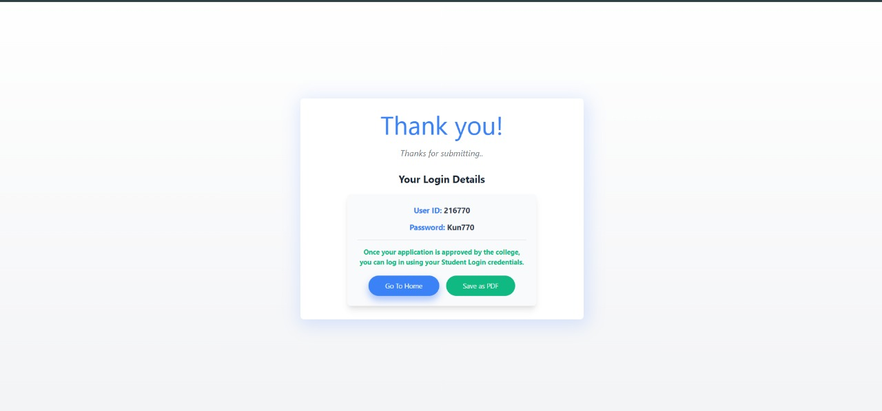
(III) Login Credentials Confirmation
Save your User ID and Password securely for future login. You can download the details as a PDF and log in once your application is approved.

Slide 6
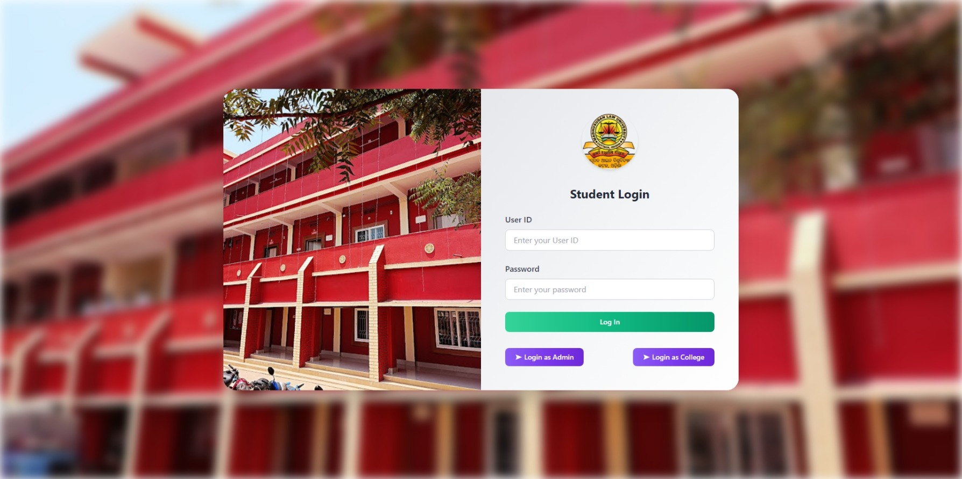
Step 2: Enter Your Credentials
Username: Enter your university-provided Exam Roll Number in the "Username" field. This is typically your student ID
Password: Enter the password associated with your account. The default password is a combination of the first three capital letters of
your name and the last three digits of your Exam Roll Number.
Example: If your name is John Doe and your Exam Roll Number is 123456, your default password will be JOH456.

Slide 7
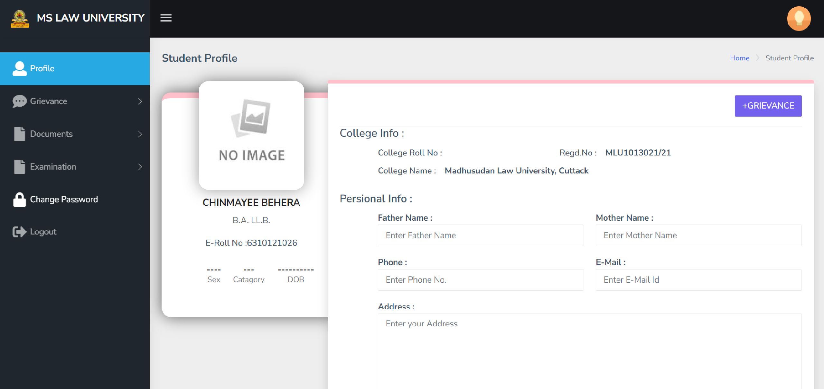
Step 3: Your Dashboard
After logging in, you will be directed to your Student Profile dashboard, where you can view and manage your academic information. For your security, please update your password immediately. Go to the Change Password section to set a new, secure password.

Slide 8
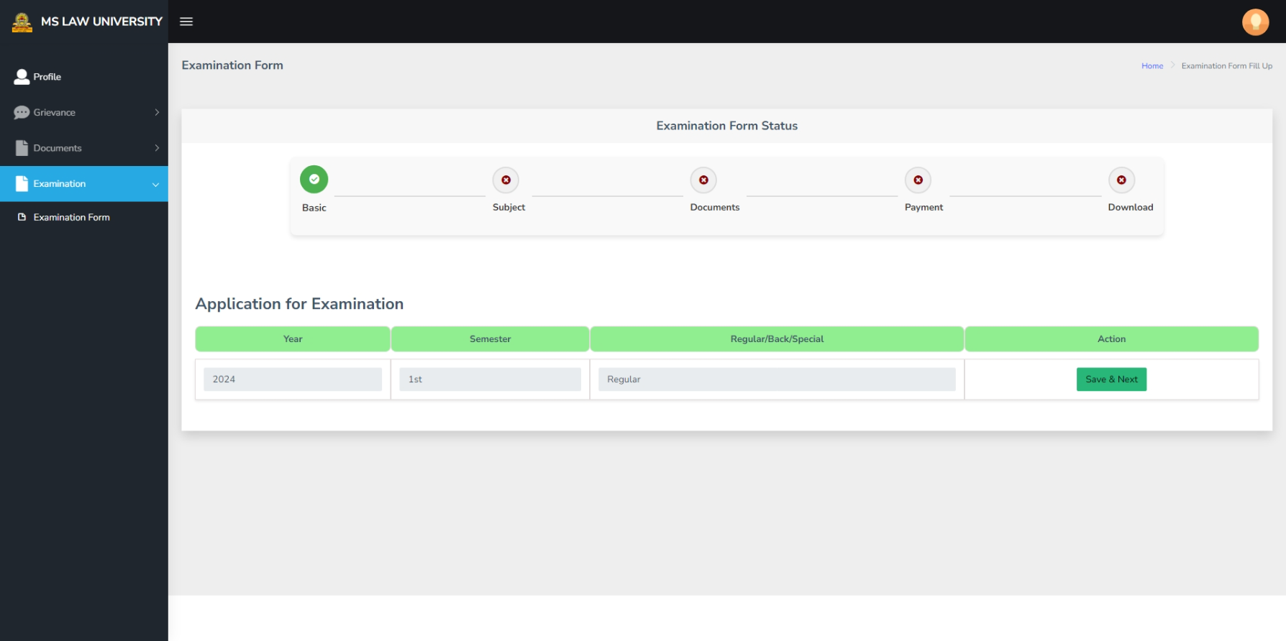
Step 4: Fill Your Examination Form 1.Navigate to the Examination Section:
From your dashboard, click on the "Examination" menu on the left-hand side.
Under this section, select "Examination Form" to access the form-fill-up page.

Slide 9
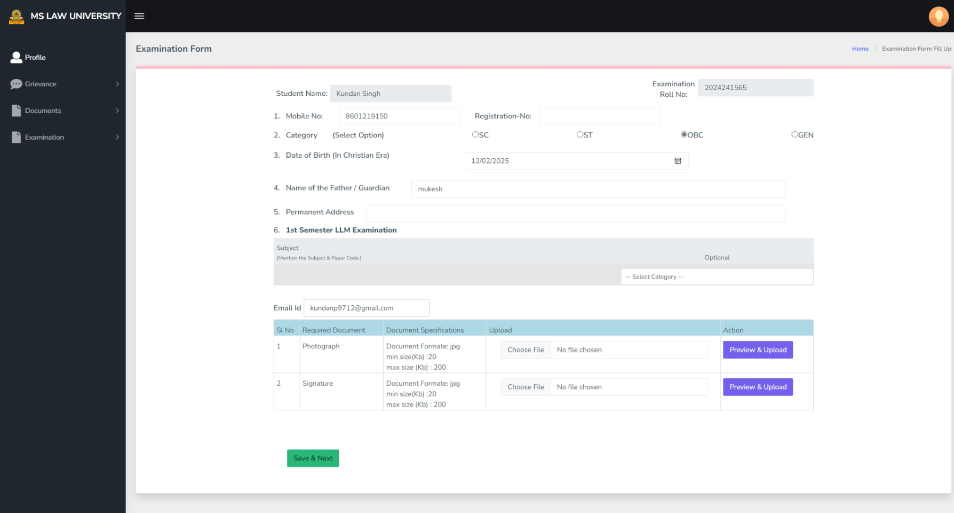
Step 5: Fill Your Examination Form
Please fill in your basic details accurately, including your mobile number, category, date of birth, your father's or guardian's name, and your permanent address. Make sure to select your subjects for the examination and provide a valid email ID for communication.

Slide 10
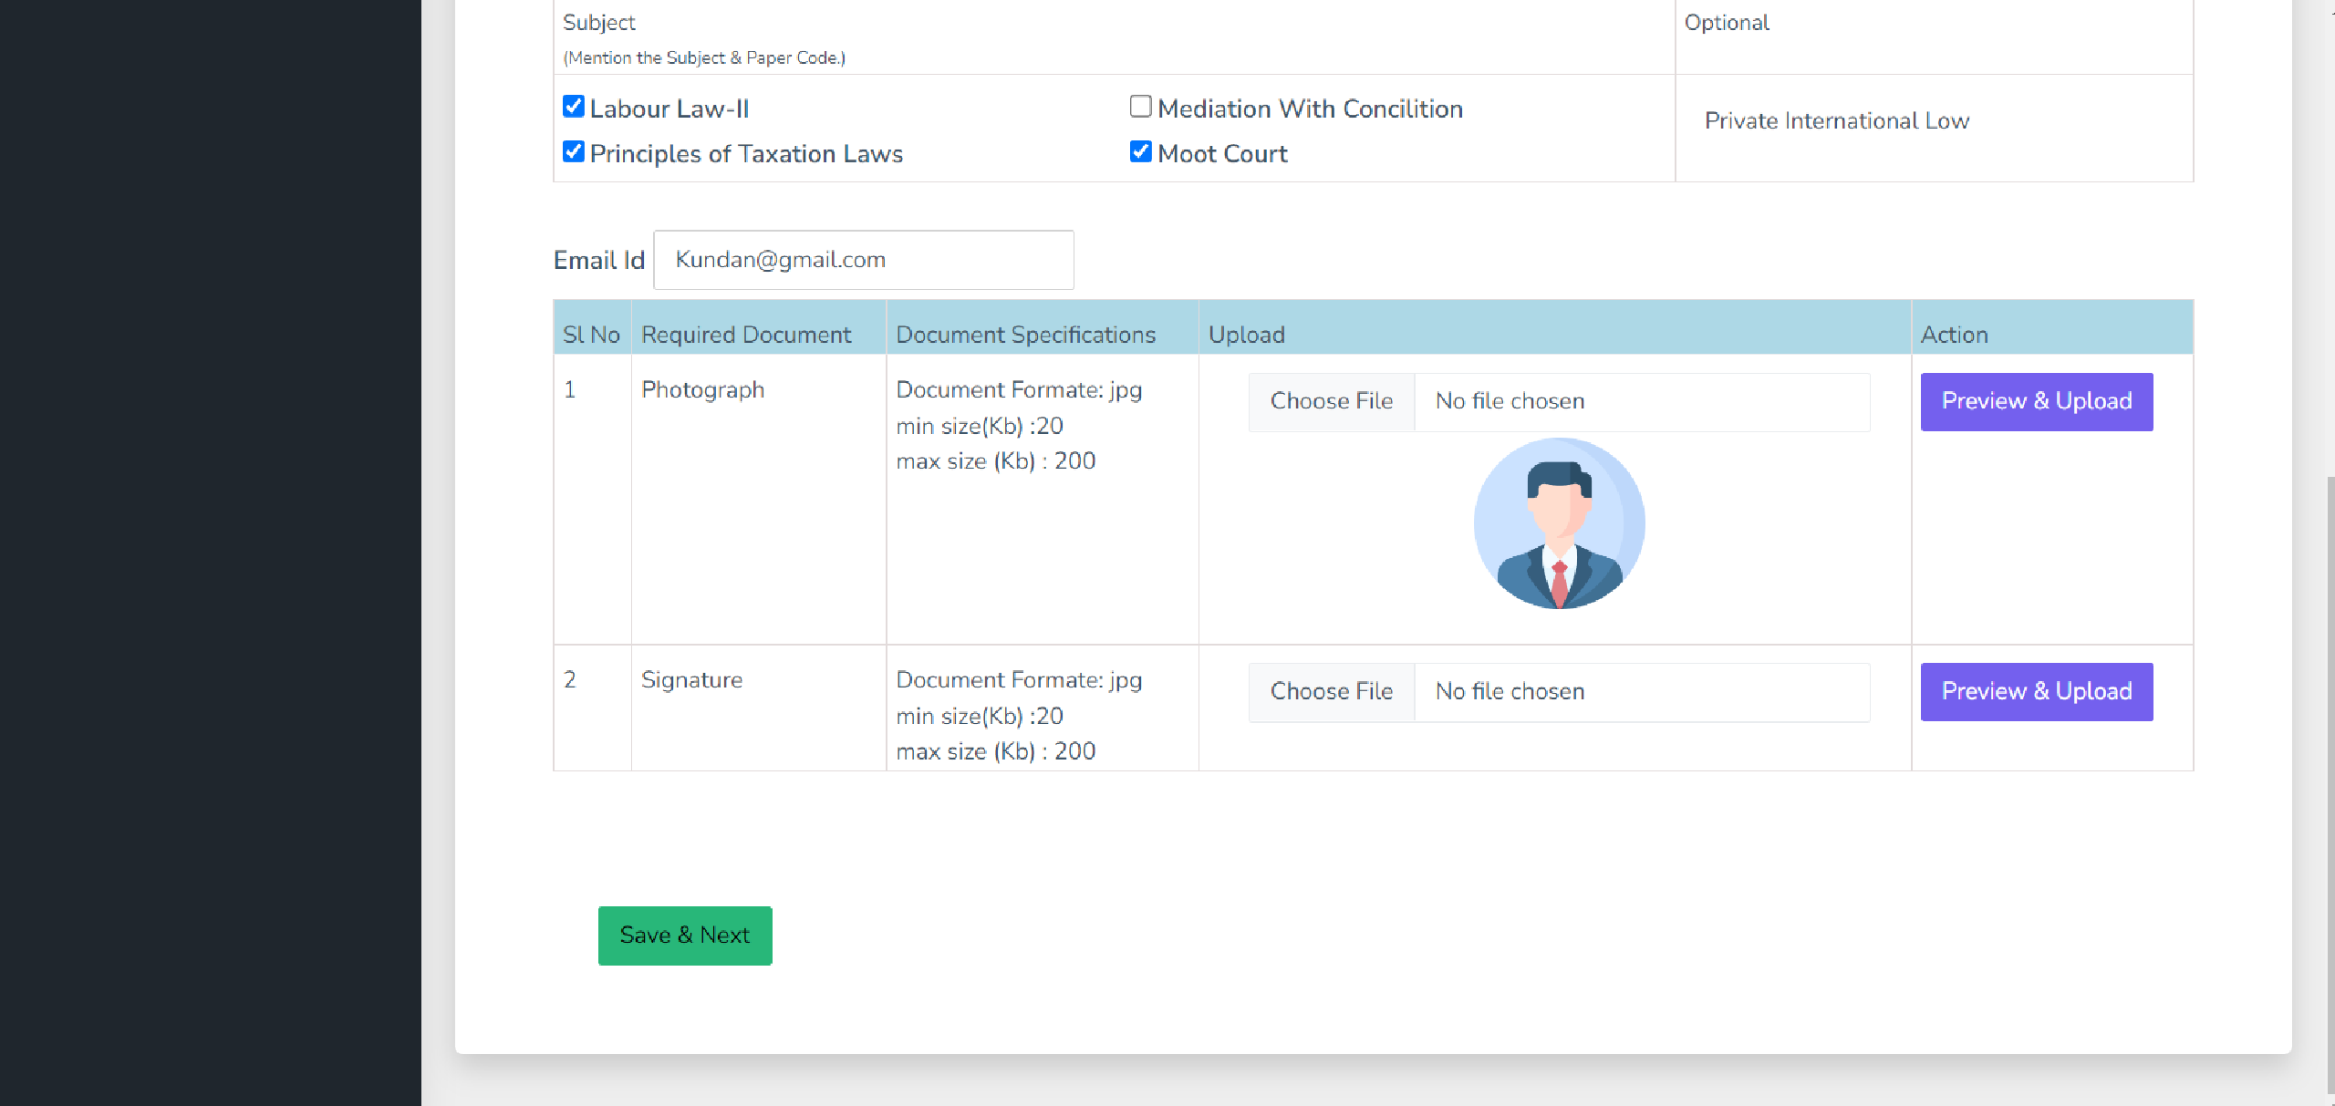
Step 5: Fill Your Examination Form
please upload your signature and a recent passport-sized photograph. Ensure that both files are clear and meet the required specifications for a smooth submission. (i) Choose file and Click To Preview & Upload

Slide 11
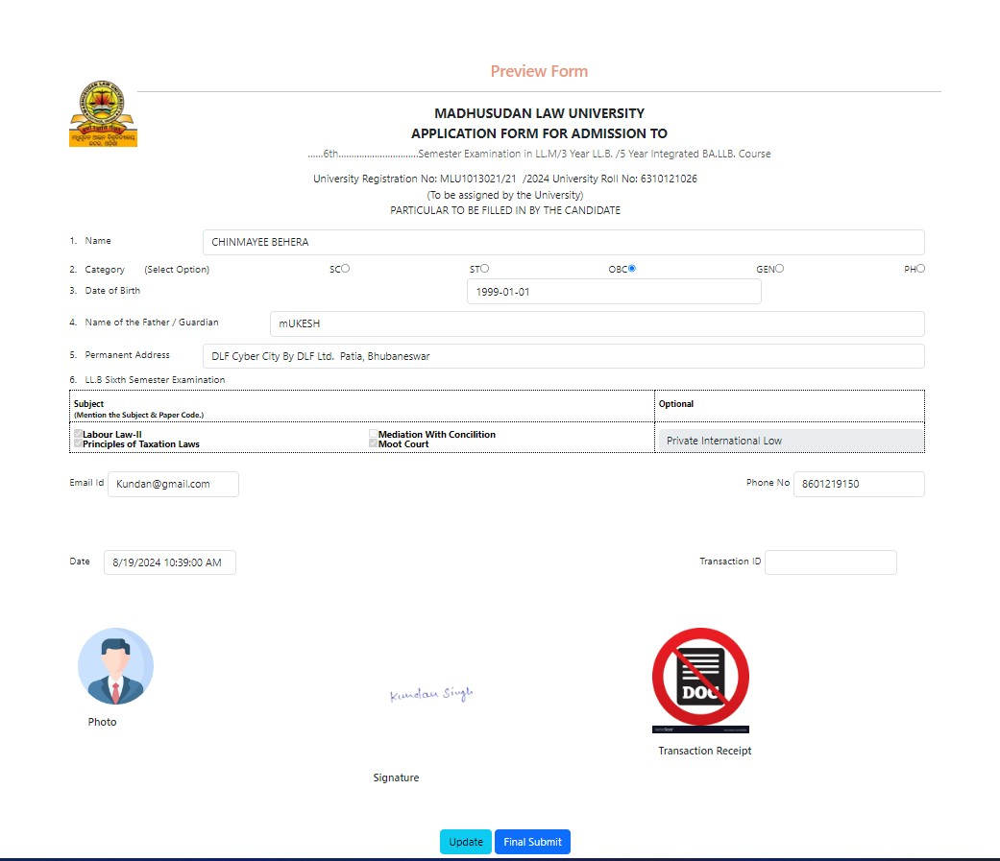
Step 6: Examination Fee Payment
review the information on your Examination form carefully. If everything looks correct and you are satisfied with the details, click the Final Submit button. If you need to make any changes, click the Update button to revise your form.

Slide 12
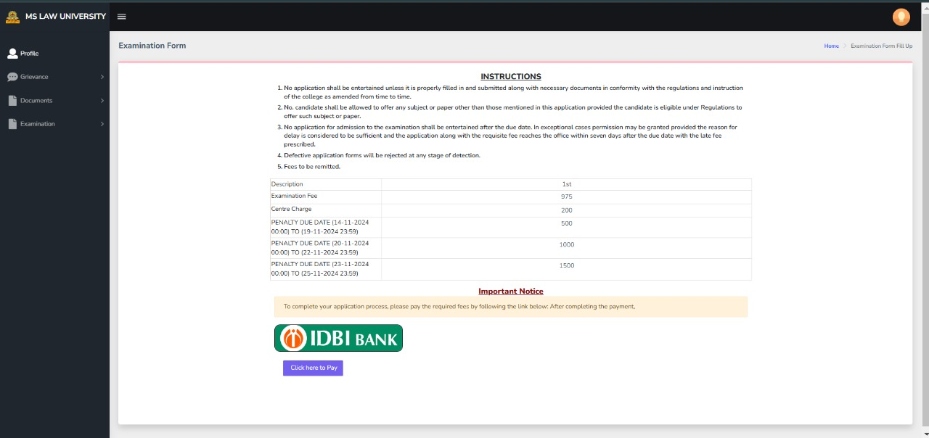
Step 7: Examination Fee Payment
After completing your form, proceed to pay the examination fee. Please review the fee details carefully before making the payment. Click the "Pay Now" button to proceed with the payment, and ensure the transaction is successful.

Slide 13
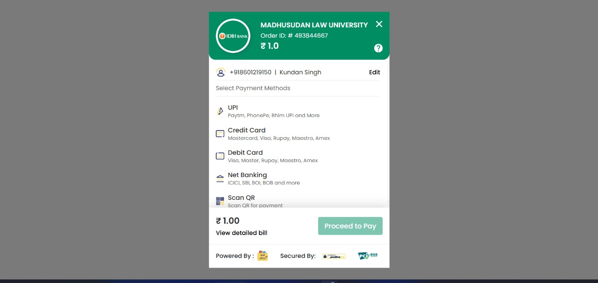
Step 8: Examination Fee Payment
Select your preferred payment method and complete the transaction. After a successful payment, wait for GetePay approval before proceeding.

Slide 14
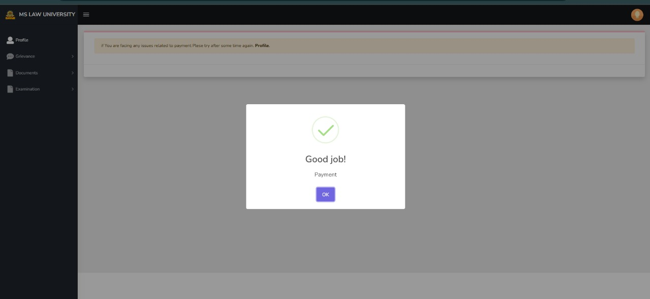
Step 9: Payment Confirmation
Your payment has been successfully processed. If you face any issues, please try again later or check your profile for updates.

Slide 15
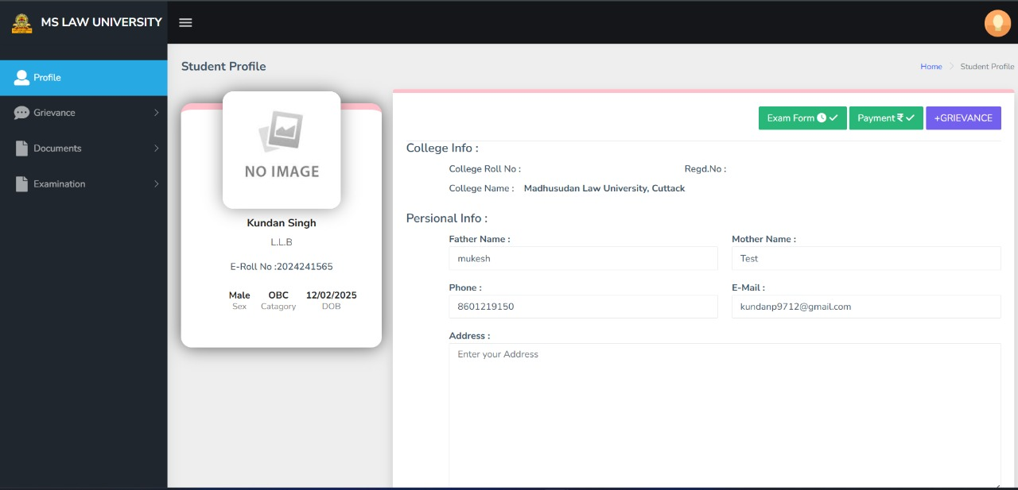
Step 10: Student Profile
Ensure all personal and college details are correct. After successful payment, the "Exam Form" and "Payment" text background colour should turn green, indicating successful processing that you can see in your Profile Page. If it does not appear green in your profile, contact your college immediately.

Slide 16
THANK YOU

